Slide 1

The A-MAIZE-ING TRIO!!!
Notes:
Max 9-12 19-22

Slide 2

Reproduced by
Christian Montes, Maxwell McReynolds, Brian Zebosi
Notes:
Max 9-12 19-22

Slide 3
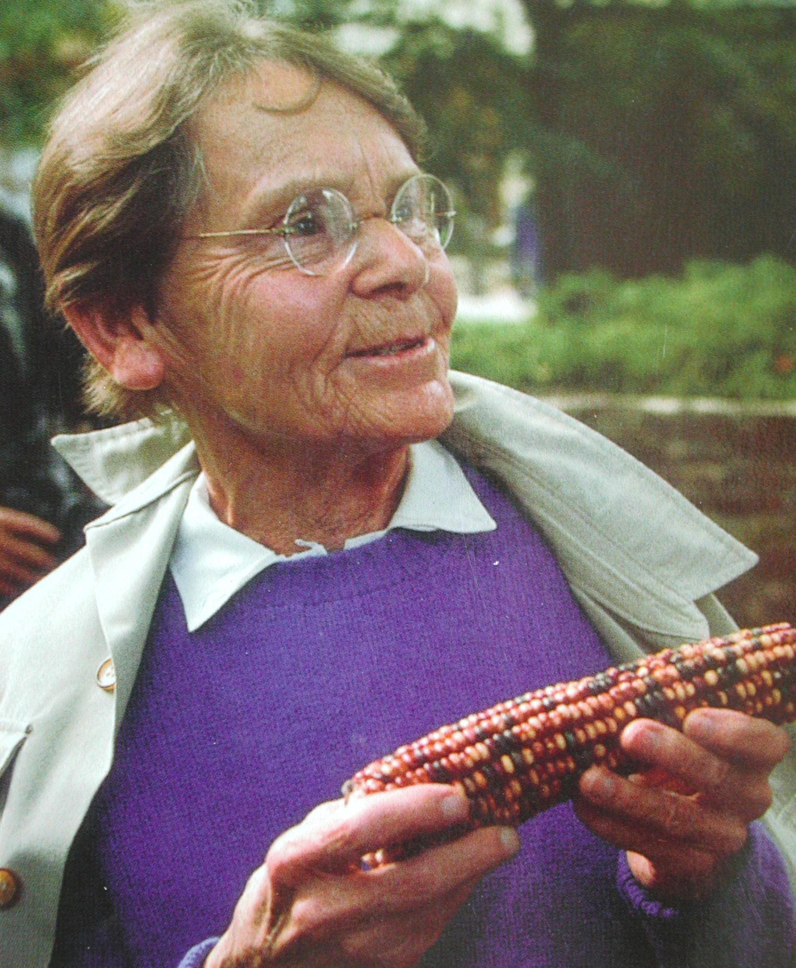
Background: Introduction
Transposable elements (TEs)
First identified by Barbara McClintock
Mobile DNA / Jumping genes
contribute ∼85% to the maize genome
“Junk” DNA
Deleterious effects
http://www.fembio.org/images/biografien/WF-barbara-mcclintock.jpg
Notes:
TEs make up approximately 50% of the human genome and up to 90% of the maize genome

Slide 4
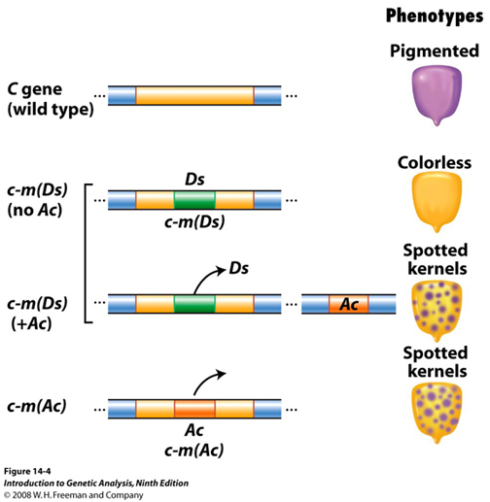
Transposon Insertion Mechanism
Notes:
Autonomous and Nonautonomous Elements
In plants, there are two types of transposable elements:
1. autonomous elements (these can tranpose by themselves)
2. nonautonomous elements (which need the input (i.e., enzymatic product) of a separate element in order to transpose).
Insertion of either type of element into a gene causes that gene to be disrupted, producing a mutant phenotype
Insertion of an autonomous element is unstable, because it can direct its own transposition over and over. The mutation can occur in each generation; the allele produced by the insertion is called a mutable allele because of its instability.
Top row: Wild type pigmented kernel.
Second row: Ds is inserted into pigment gene (C) permanently, disabling it. By itself, it can't move. It's stuck. Ds is a non-autonomous element.
Third row: Ds and Ac both present, Ds can now excise from the C gene in some cells (i.e., it can transpose) during development, creating developmental fields that can produce pigment. This is because Ac has provided the elements needed for Ds to transpose.
Fourth row: Ac is inserted into pigment gene, but not permanently, as it can provide the elements that allow its removal from the gene. Ac is an autonomous element.

Slide 5
Background :- Introduction
Transposable elements (TEs)
First identified by Barbara McClintock
Mobile DNA / Jumping genes
contribute ∼85% to the maize genome
“Junk” DNA / selfish DNA
Deleterious effects
“Controlling elements”
Interacts with host genes
Influences expression of nearby genes
http://www.fembio.org/images/biografien/WF-barbara-mcclintock.jpg
Notes:
TEs make up approximately 50% of the human genome and up to 90% of the maize genome

Slide 6
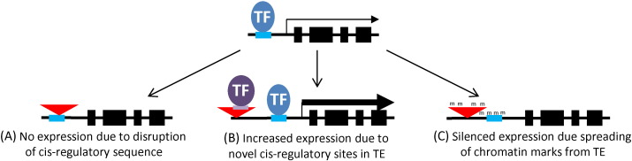
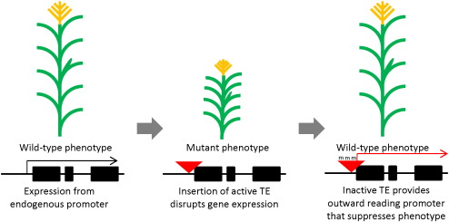
TEs Affect Gene Function
TEs as controlling elements
Insert within introns or untranslated regions
provide novel alternative promoters
Insert near genes - novel cis-acting regulatory
Behave as enhancers/repressors
insert within existing enhancers
chromatin modifications in regions near genes
https://ars.els-cdn.com/content/image/1-s2.0-S1874939916301006-gr3.jpg
https://ars.els-cdn.com/content/image/1-s2.0-S1874939916301006-gr2.jpg
Notes:
TEs can provide novel alternative promoters, which can lead to new expression patterns or original coding potential of an alternate transcript

Slide 7
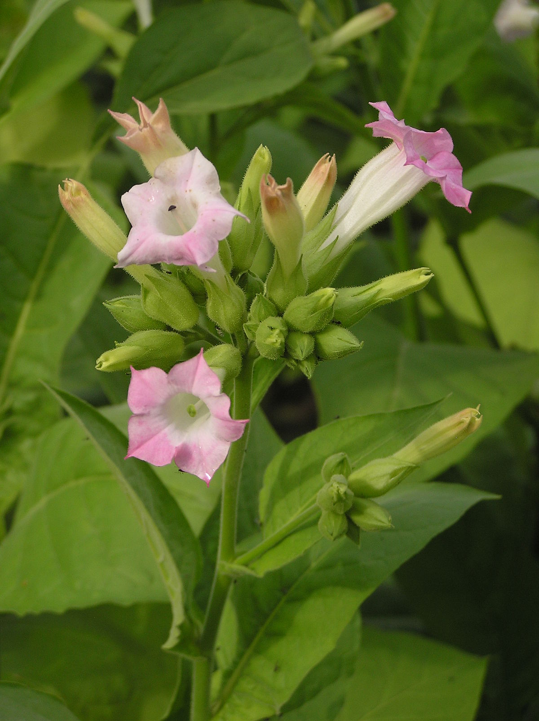
Transposons as Controlling Elements
TEs exhibit stress-responsive transcription/movement
Tnt1 element induced by biotic and abiotic stress
Notes:
Nicotiana tabacum TNT1 element induced by biotic and abiotic stress

Slide 8

Transposons as Controlling Elements
TEs exhibit stress-responsive transcription/movement
ONSEN retrotransposon transcriptionally activated by heat stress
Notes:
Arabidopsis thaliana

Slide 9

Transposons as Controlling Elements
TEs exhibit stress-responsive transcription/movement
mPing transposon is activated in response to cold and salt stress
Notes:
Oryza sativa japonica

Slide 10

Literature Summary: Rationale and Questions
Gap in knowledge of what maize TEs and TE-controlled genes are modulated by abiotic stress
What’s the genome-wide influence of TEs on gene expression in response to abiotic stress?
TEs have control over stress-responsive genes but their mechanism remains unclear
By which mechanism are TEs modulating expression changes?
Our Goal: Complete an RNA-seq analysis to generate differential gene expression data for downstream analysis

Slide 11


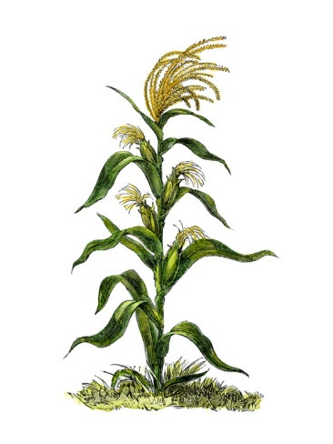

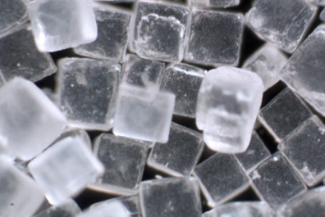
Literature Summary: Experimental Conditions
Three maize genotypes
B73
Mo17
Oh43
Four abiotic stress conditions
Heat
Cold
Salt
Ultra Violet (UV) Light
Extracted RNA from samples

Slide 12
Literature Summary: RNA-Seq
RNA-sequencing of maize exposed to abiotic stress
RNA-seq analyzes the transcriptome via Next Generation Sequencing
Presence and quantity
Splice events
Post-transcriptional modifications
SNPs/mutations
Changes in expression

Slide 13
RNA-Seq: Transcriptomic Data Set Preparation
RNA samples prepared into TruSeq libraries
Template molecules suitable for DNA sequencing
Samples sequenced on Illumina HiSeq 2000
10-20 million reads per sample
Our analysis showed 10-40 million reads per sample
Reads deposited on NCBI SRA (Short Read Archive) as SRA format files
Data inspection
33 paired end runs (2x51bp)
66 files in total
85GB total size
Notes:
This protocol explains how to convert the mRNA in total RNA into a library of template molecules suitable for subsequent cluster generation and DNA sequencing using the reagents provided in the Illumina® TruSeq® RNA Sample Preparation Kit v2. The first step in the workflow involves purifying the poly-A containing mRNA molecules using oligo-dT attached magnetic beads. Following purification, the mRNA is fragmented into small pieces using divalent cations under elevated temperature. The cleaved RNA fragments are copied into first strand cDNA using reverse transcriptase and random primers. Second strand cDNA synthesis follows, using DNA Polymerase I and RNase H. The cDNA fragments then go through an end repair process, the addition of a single ‘A’ base, and then ligation of the adapters. The products are then purified and enriched with PCR to create the final cDNA library.

Slide 14
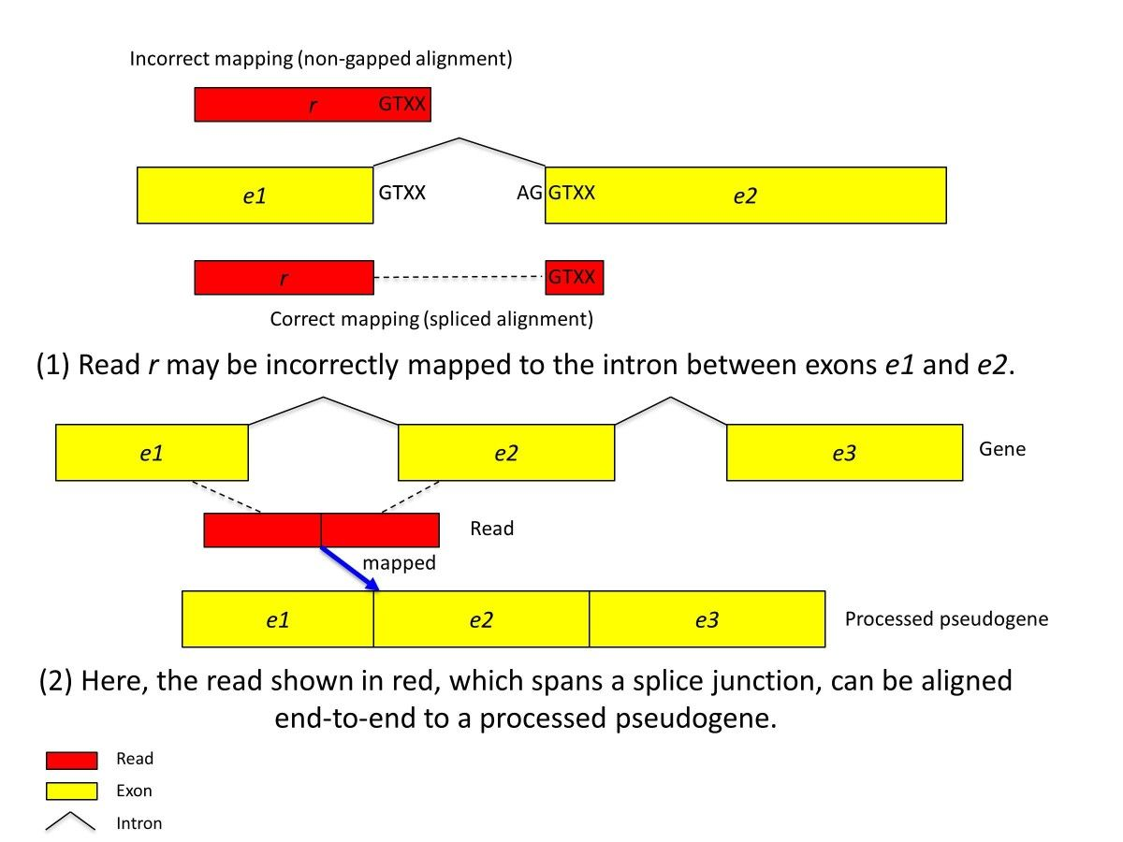
Description of Workflow
What the authors say
reads
Illumina Hiseq2000
Tophat
Gapped alignment
Bam to counts
Aligned fragments to transcript counts
DESeq
Counts to differential expression profile
Happiness
^_^

Slide 15
Description of Workflow
What the authors say
What we really did
reads
Get the read name using NCBI Bioproject accession
Download the reads
Used “edirect” software
Used “sra toolkit” software on hpc-class
Reads’ names
(SRR.numbers)
esearch -db sra -query PRJNA244661 | efetch --format runinfo |cut -d "," -f 1 > SRR.numbers
Bioproject accession from paper
List of read names

Slide 16
Description of Workflow
What the authors say
What we really did
reads
Get the read name using NCBI Bioproject accession
Download the reads
Used “edirect” software
Used “sra toolkit” software on hpc-class
Reads’ names
(SRR.numbers)
cat SRR.numbers | xargs -P 6 -I xx fastq-dump --split-files --gzip xx

Slide 17
Description of Workflow
What the authors say
What we did
reads
33 runs = 66 files = 85 Gb = need a script to download
Tophat
Had to infer insert size and standard deviation and arguments.Used a batch script to go over all files
Bam to counts
Not in the hpc-class, used HTSeq-count.
DESeq
Work as intended, had to figure out how to use it
Happiness
Well...

Slide 18
Documentation Overview
We used the following documenting resources for our work:
Github repository, containing:
Commented scripts
Readme files
Project paper
Analysis results
Note: the GitHub repository is not big enough to store the raw files, the analyzed files, or any intermediate results.

Slide 19
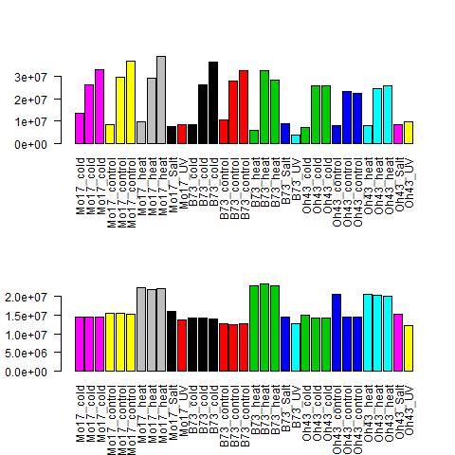
First results: looking at the count data
[chrisfm@hpc-class input_files]$ ls -lh SRR1685982* SRR1819622* SRR1819624*
-rw-r--r--. 1 chrisfm dusers 640M Dec 1 06:57 SRR1685982_1.fastq.gz
-rw-r--r--. 1 chrisfm dusers 661M Dec 1 06:57 SRR1685982_2.fastq.gz
-rw-r--r--. 1 chrisfm dusers 2.0G Dec 1 09:03 SRR1819622_1.fastq.gz
-rw-r--r--. 1 chrisfm dusers 2.0G Dec 1 09:03 SRR1819622_2.fastq.gz
-rw-r--r--. 1 chrisfm dusers 2.7G Dec 1 09:21 SRR1819624_1.fastq.gz
-rw-r--r--. 1 chrisfm dusers 2.7G Dec 1 09:21 SRR1819624_2.fastq.gz

Slide 20
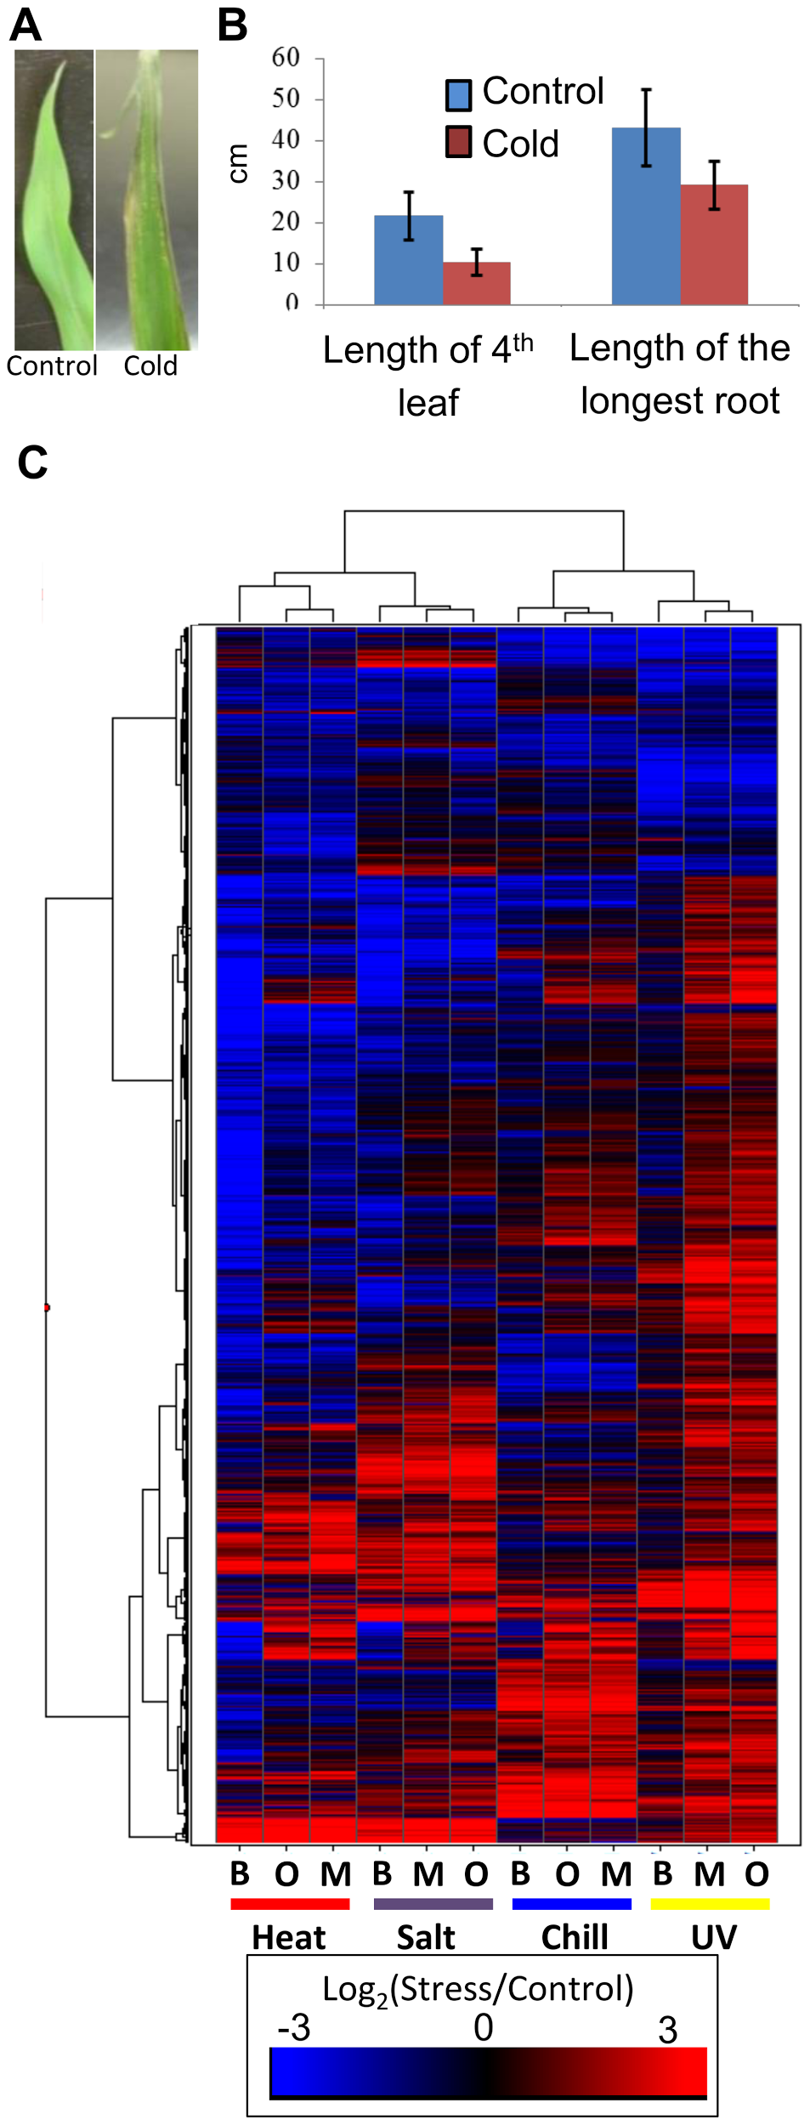
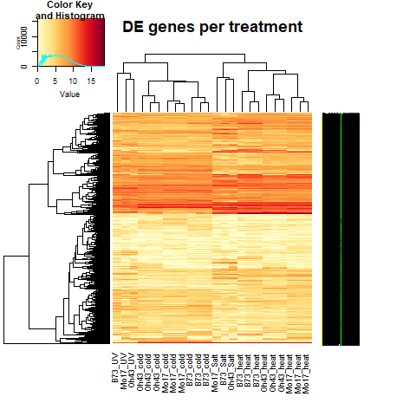
Results Comparison, Differentially Expressed Genes
Springer et al
The A-MAIZE-ing Trio
Notes:
Suggests that each stress has a substantial influence on the maize transcriptome.
The three inbred lines showed similar transcriptional responses to the stress conditions but there is evidence of genotype specific responses.
Great platform of data to begin downstream analysis of the transposons located near the genes

Slide 21
Results Comparison, Differentially Expressed Genes
Similarity:
Stress has substantial influence
over gene expression
Notes:
Suggests that each stress has a substantial influence on the maize transcriptome.
Different scale, same behaviour similar trend

Slide 22
Results Comparison, differentially expressed genes
Similarity:
Clustering of the stresses in relation to each other
Slight variation:
The clustering of the genotypes
Notes:
Suggests that each stress has a substantial influence on the maize transcriptome.
The three inbred lines showed similar transcriptional responses to the stress conditions but there is evidence of genotype specific responses.
Great platform of data to begin downstream analysis of the transposons located near the genes

Slide 23
Results Comparison, differentially expressed genes
 | The A-maize-ing-trio |  |  | Springer et al
 | Mo17 | B73 | Oh43 | Mo17 | B73 | Oh43
Cold | 2,579 | 2,211 | 2,461 | 5,309 | 4,819 | 4,668
Heat | 3,106 | 3,614 | 634 | 5,310 | 5,114 | 5,438
Salt | 2,084 | 3,105 | 2,335 | 5,118 | 5,986 | 5,712
UV | 2,244 | 1,710 | 2,296 | 4,120 | 3,823 | 4,555
Total DE genes (non redundant) | 7,502 |  |  | Not provided

Slide 24
Whoa… what happened? Some thoughts
Ours is normalized counting they did RPKM then counting based on that
DESeq recommends raw counts
Different version of DESeq package
DESeq1 vs DESeq2
The reference genome is a different version between ours and Springer et al.
Version2 vs Version4

Slide 25
What We Learned
How to extrapolate RNA-sequencing data
Various processes and packages for analysis
There are gaps in the analysis outlined in the paper versus the actual analysis
Some key steps can be missing
Differences in package versions, reference genomes, etc.
Documentation is important for reproducibility
Improper uploading/downloading of data can cause headaches
Corrupt files
Multiple ways to apply material learned in the class to various forms of large data
Notes:
The analysis of the stress-induced transcripts and proximity of the transposon to the gene suggests that these TEs may provide local enhancer activities that stimulate stress-responsive gene expression. Our data on allelic variation for insertions of several of these TEs show strong correlation between the presence of TE insertions and stress-responsive up-regulation of gene expression. Our findings suggest that TEs provide an important source of allelic regulatory variation in gene response to abiotic stress in maize.

Slide 26

Questions?

